Slide 1
Team #15
Sara Carter · Sophie Jack · Ben Eber · Spyridon Mazis · Chris Witherspoon

Slide 2
Matrix of Resposibility:
First stage prop. (columns) - Second stage prop. (rows) | LOX/LCH4 | LOX/LH2 | LOX/RP1 | Solid | Storables
LOX/LCH4 | Ben | Ben | Ben | Ben | Ben
LOX/LH2 | Sara | Sara | Sara | Sara | Sara
LOX/RP1 | Spyros | Spyros | Spyros | Spyros | Spyros
Solid | Sophie | Sophie | Sophie | Sophie | Sophie
Storables | Chris | Chris | Chris | Chris | Chris

Slide 3
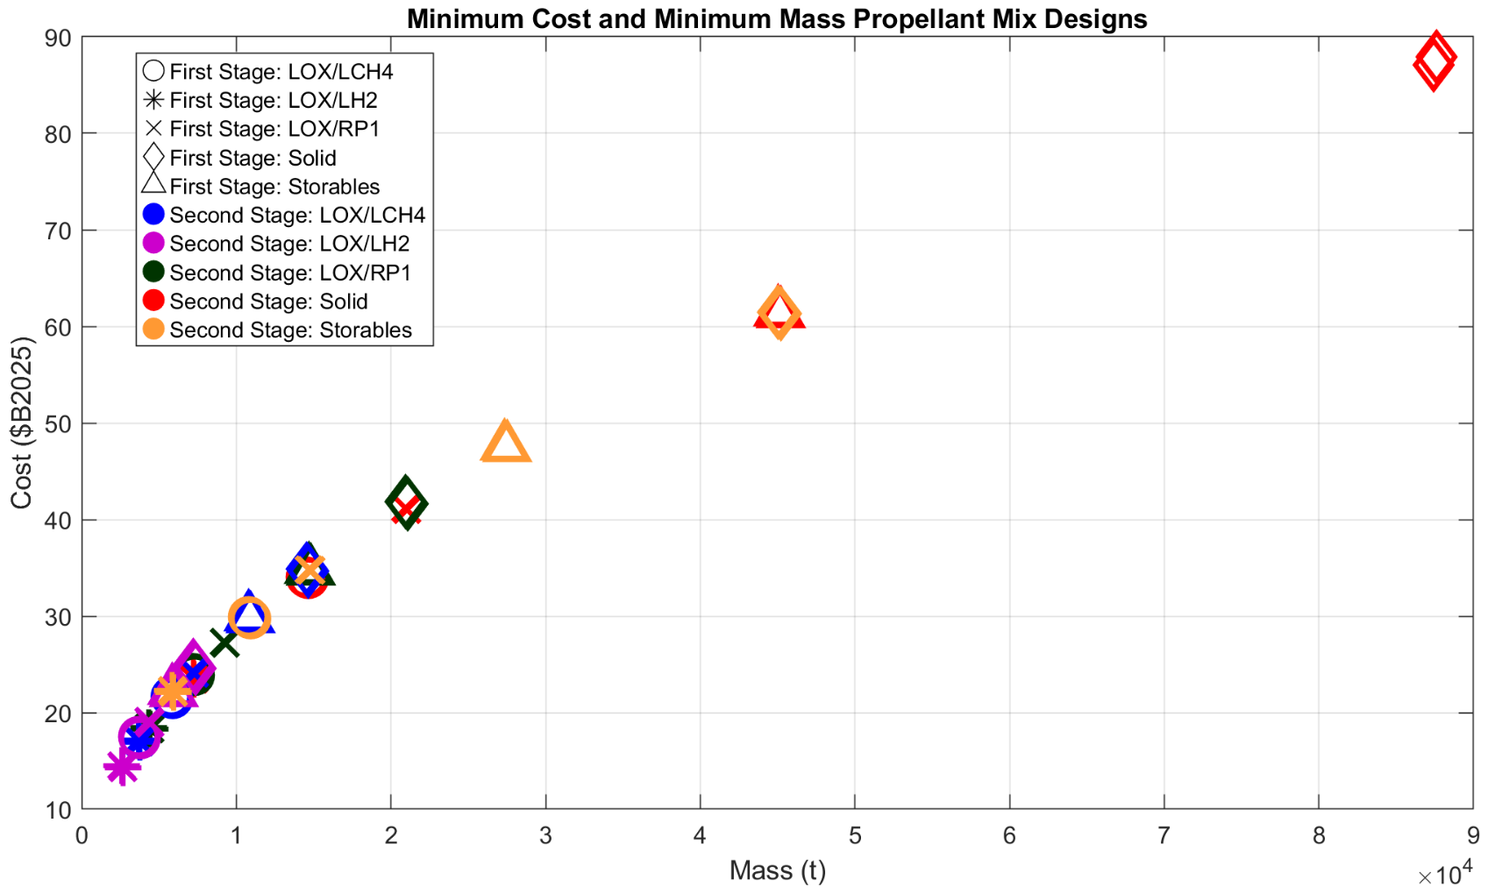
Full Graph of Results

Slide 4
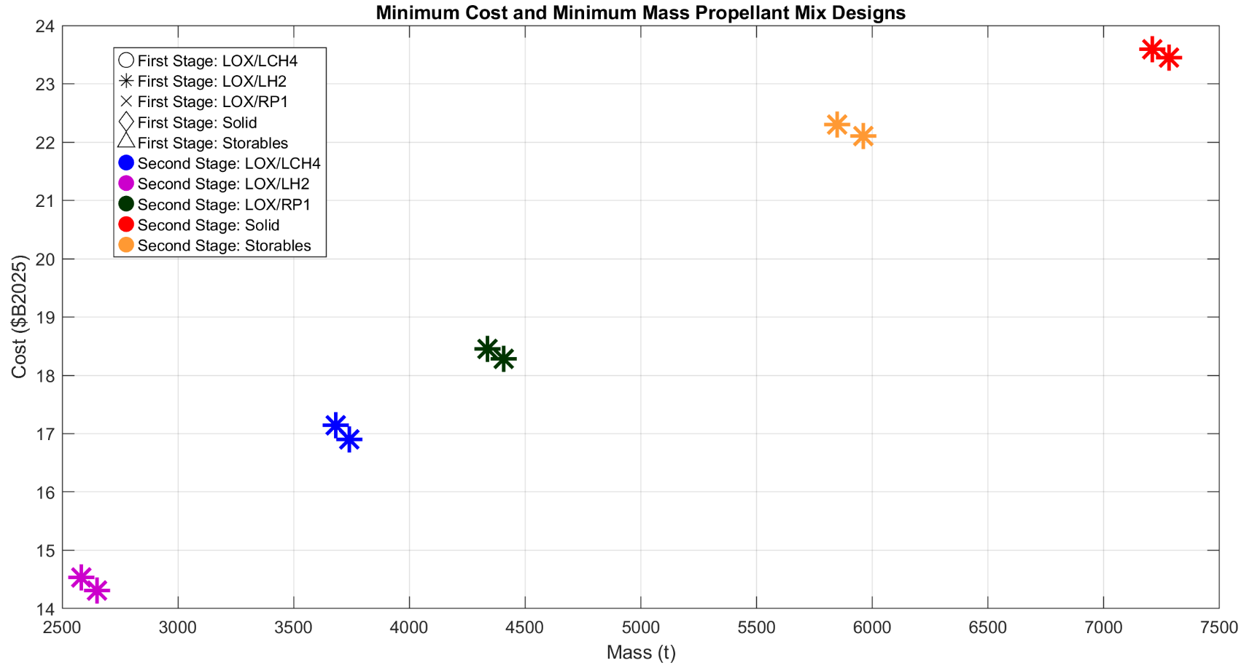
Top Mass/Cost Results

Slide 5
Trade Study and Conclusion
From the data, the LOX/LH₂ + LOX/LH₂ combination was most optimized for mass and cost
Minimum Mass: [2582 (t), $B2025: 14.53]
Minimum Cost: [2650 (t), $B2025: 14.31]
H₂ is temperamental
It needs cryogenic cooling, the technology for which is not available
Higher I_{sp} in electric, but provides low thrust
Isp doesn’t paint a full picture of how to get a launch vehicle from the ground into space
Future analyses will paint a fuller picture by deriving ṁ from T2
Our analysis is dependent on consistent 𝝳 = 0.08, this might not be reflective of actual performance

Slide 6
Driving “top” results
The Isp of the first stage seems to be a strong driving force.
The higher the initial Isp the lower the cost and minimum mass
In accordance with what we have learned in lecture, the higher the Isp, the higher the force per kg provided
The Isp of the second stage also makes an impact on the minimum cost and mass as a two stage rocket uses all of its resources.
The second stage Isp seems to be the deciding factor if, within the subsect of the first Isp, the launch vehicle will be at the top or bottom mass/cost for the group.
Looking at the ΔV equation, I_{sp} directly correlates to its value
ΔV_{i} = - V_{e,i}*ln(m_{f,i}/m_{in,i})
I_{sp}*g_{o}= V_{e}

